Slide 1
Educational Applications at THE University of Twente
As used for master students
CES
Version 8.0, July 2018

Slide 2
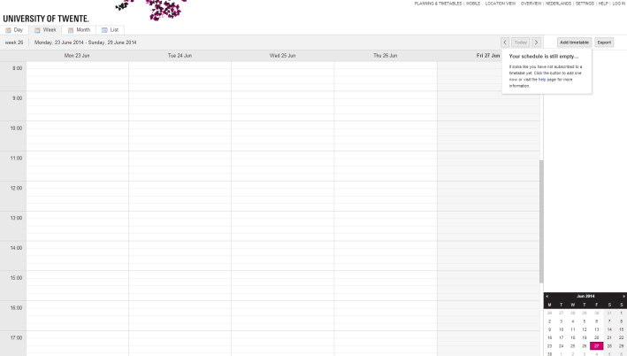
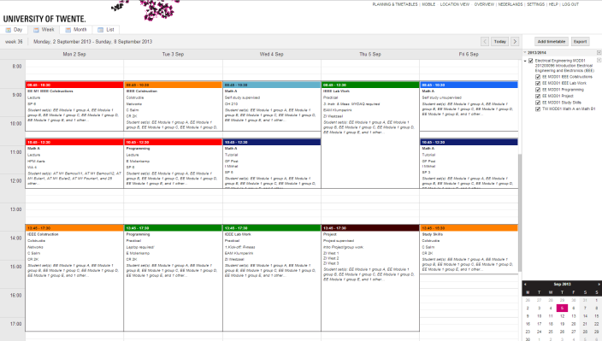
MyTimetable
Personal timetable
Create a personal timetable
Timetable can be exported (PDF, CSV, iCal)
Subscription is also possible!
Via https://rooster.utwente.nl
Log in with your student account
Mobile webpage available as well

Slide 3
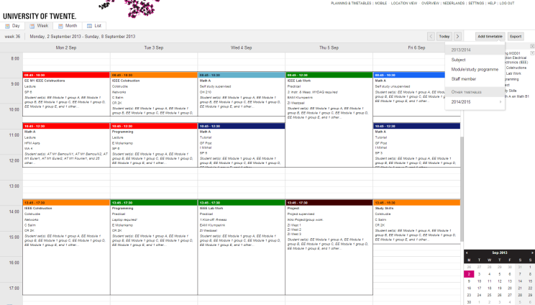
MyTimetable
Adding a timetable
The addition of timetables can be done for study programmes and/or for subjects
Make sure to select the right academic year

Slide 4
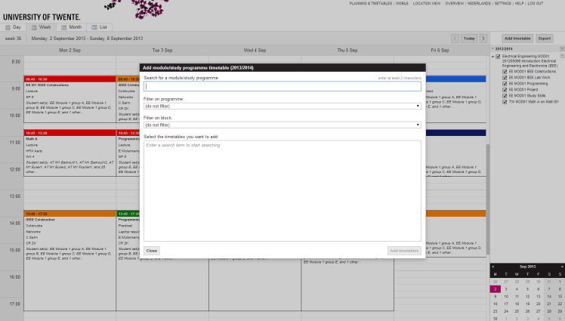
MyTimetable
Adding a timetable
The addition of timetables can be done for study programmes and/or for subjects
Make sure to select the right academic year
Search for a module by its name or filter by study programme/block

Slide 5
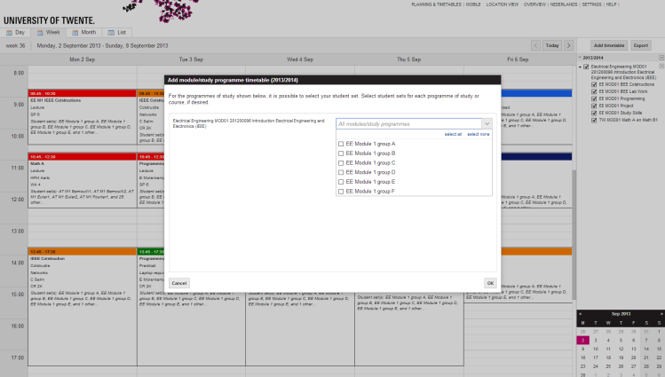
MyTimetable
Adding a timetable
The addition of timetables can be done for study programmes or for subjects
Make sure to select the right academic year
Search for a module by its name or filter by study programme/block
Add the programme of either your own or all study groups

Slide 6
mytimetable
Personalize
Turn on or off study programmes or subjects
Using the checkboxes

Slide 7
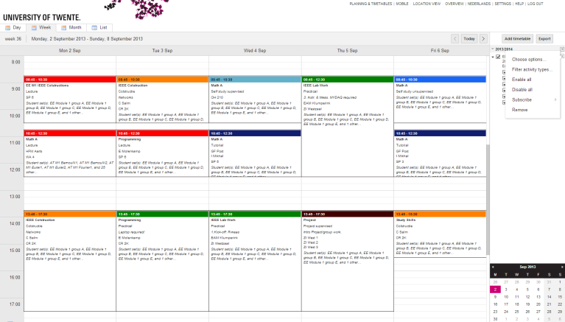
mytimetable
Personalize
Turn on or off study programmes or subjects
Using the checkboxes
Turn on or off activity types
Using “Filter activity types”

Slide 8
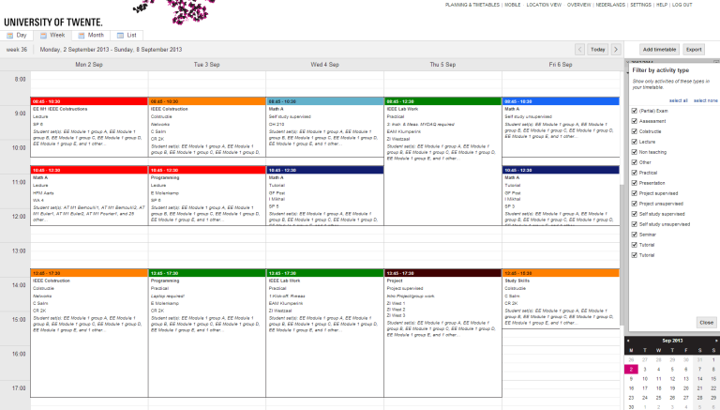
mytimetable
Personalize
Turn on or off study programmes or subjects
Using the checkboxes
Turn on or off activity types
Using “Filter activity types”
Uncheck unwanted activity types
Or “Select none” to be able to then check all wanted activity types
This way, you can e.g. filter for only exams!

Slide 9
MyTimetable
Subscribing and exporting
Subscription in
Microsoft Outlook
Google Calendar
Apple Calendar
Other programme (using iCal link)
Export as
PDF
CSV
iCal

Slide 10
MyTimetable
functionality
Mobile version available
Calendar can be tweaked to your own demands
Filter by subjects
Filter by activity types
When subscribed to a timetable, changes are made automatically within 15 minutes
Questions?
Check the built-in HELP functionality
Contact SNT (http://www.snt.utwente.nl/)

