Slide 1
MONITORING AND MAPPING AGRICULTURE: BETTER, FASTER, CHEAPER
Andy Nelson - Professor, Spatial Agriculture and Food Security
Department of Natural Resources
Faculty of Geo-Information Science and Earth Observation
7th Sep 2016

Slide 2
How can innovations in geospatial technologies and methods reduce conventional agricultural data challenges, generate better baselines, and monitor progress?
Farmer with his mobile phone in Bihar, India (M. DeFreese/CIMMYT)
Notes:
This farmer in India may not have a smart phone, but the information that he receives should help him to become a smarter farmer doing smarter agriculture
https://www.flickr.com/photos/cimmyt/8048414699/in/photolist-dgdehF-dgdeke-dar4YZ-871Cmu-ogXRA4-8fWCrC-8fWPEj-7odGkr-8fTsX2-8fWKY1-8fTxm4-8fTz2B-7oi14G-8fUTfM-8fTADc-8fTtA4-8fTzwZ-8fTson-8fWQcC-8fTouX-8fWMc1-8fWD1f-dmyNXT-cfCvH1-5S5Vhv-9ptQ1n-dPL2aC-263HgT-8fWHCd-8fWGtu-iJjiiM-djbLEU-8fWLzb-8fTw3V-jBBnVn-xHjE87-8fWH1E-8fUUKZ-cVAdeW-dar63U-8fUW9g-8fWDBy-8fYaAo-8fTqfV-7NX5mC-8fUVBi-8fWEMS-gHFDP9-7YUYi4-gHBWn7

Slide 3
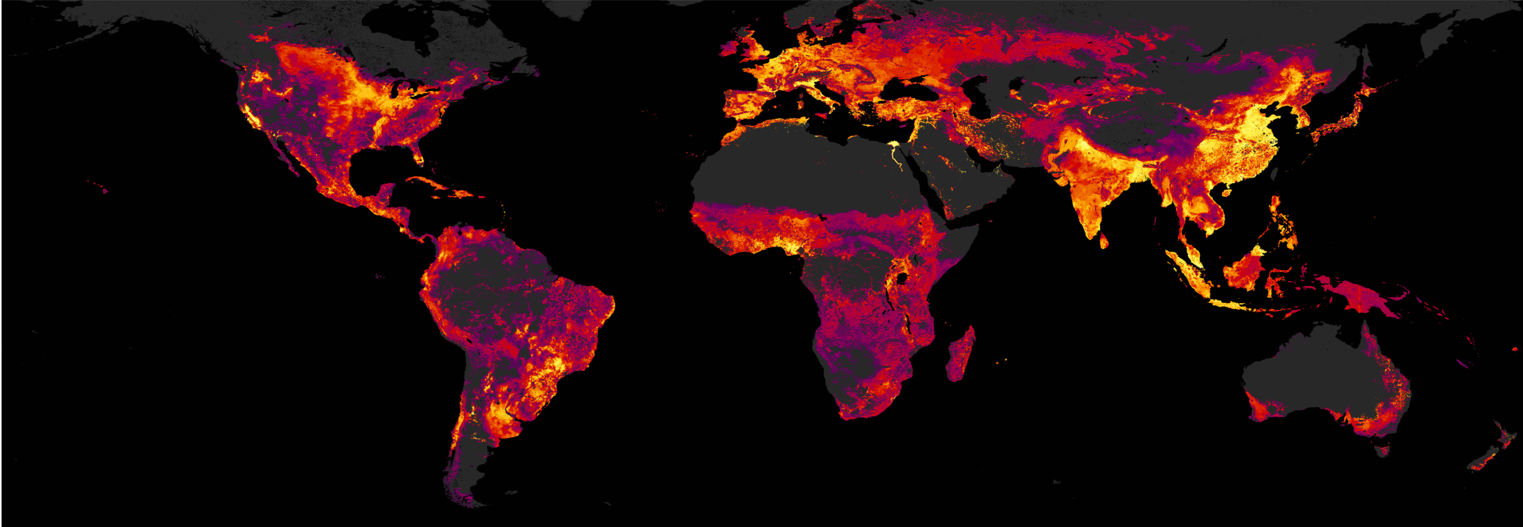
Agricultural production is worth $2.25 trillion per year
Two thirds comes from crops, one third from fisheries & livestock
The agricultural sector employs around one billion people. Around 2.6 billion people depend on agriculture for their livelihood.
Notes:
Agriculture in the economy
Instead of showing area or yield, this map shows the value of agriculture
Globally, the annual value of all agricultural production in 2013 was 2 trillion Euros
Agriculture is still a major source of employment, income and economic growth.
The agricultural sector employs around 1 billion people and in low income countries the agricultural sector provides the vast majority of the employment opportunities and accounts for one third of GDP in those countries.
Around 2.6 billion people, 40% of the world population, depend on agriculture for their livelihood, most of which live on small farms in low income countries.

Slide 4
Of the 570m farms in the world, 400m are less than 1 hectare…
…but they occupy only 8% of agricultural land.
In lower income countries, 95% of the farms are five hectares or less.
These smaller farms produce the majority of food in Africa and Asia.
Data from FAO
Notes:
The operational unit of agricultural land is the farm where decisions are made on what to grow in each parcel of land.
There are around 570 million farms in the world
Around three quarters of them (~400 million farms) are less than 1 ha in size, accounting for only 8% of all agricultural land while the top 1%, which are larger than 50 ha, account for 65%.
In low and lower middle income countries 95% of all farms are five ha or less and account for most of the agricultural land in those countries.
These smaller farms produce the majority of food in Africa and Asia.

Slide 5
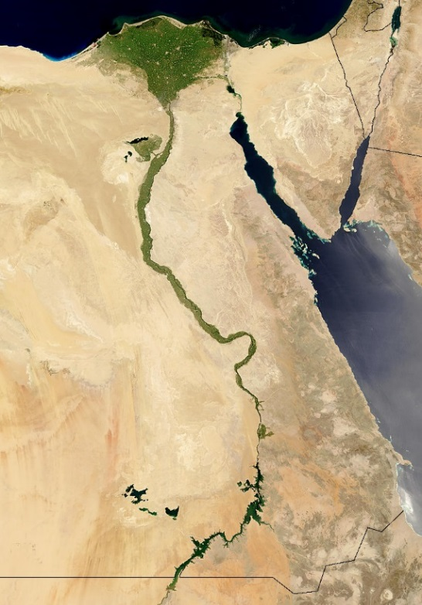
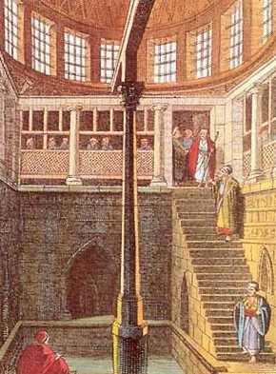
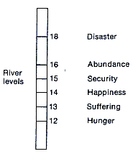
The first known crop information system
Nilometer
A graded column housed on the banks of the Nile to measure water levels at critical dates and thus predict the harvest. Nile water level measurements go back 5000 years.
Notes:
Crop information systems have been around for a very long time,
One of the first recorded information systems for food security was a water height measurement system on the River Nile some 5,000 years ago. Its called a Nilometer.
The annual flood waters of the Nile were essential for Egyptian civilization and this map shows that Nile is still clearly visible as the source of life in Egypt.
A moderate amount of water in the river from seasonal rains provided sufficient water and fertile alluvial deposits for agriculture
Too little rain would lead to shortages and famine
Too much water in the river would flood the land, wash away soil and endanger lives and infrastructure.

Slide 6
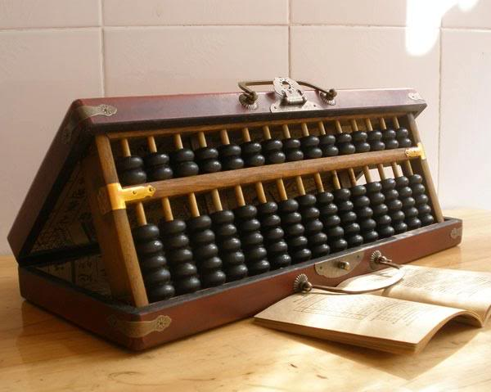
Current information
National departments of statistics and bureaus of agriculture have the responsibility to collect information on food and agriculture every year.
These are derived from representative surveys and/or field samples which means a large nationwide data collection effort every year or season or quarter.
This regular data collection needs to be consistent, of high quality and representative, and if the data are to be a useful decision support tool then they need to be available rapidly after collection.
Notes:
National departments of statistics and bureaus of agriculture have the responsibility to collect information on food and agriculture every year.
This information guides and supports policy making on agricultural production, use and preservation of natural resources, agricultural trade, rural investments, research and food safety amongst others.
These are derived from representative surveys and/or field samples which means a large nationwide data collection effort every year or perhaps more frequently (seasonally, bi-annually or quarterly for example).
This regular data collection needs to be consistent, of high quality and representative, and if the data are to be a useful decision support tool - and not merely a historical record - then they need to be available rapidly after collection.

Slide 7
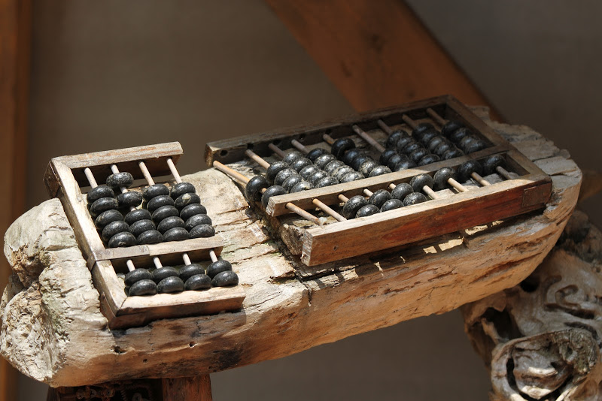
A broken system?
There is a growing concern that information on agriculture in low income countries is poor.
It is these countries where the greatest environmental and development challenges exist. These are the places where information is most needed to guide research and policy.
The lack of good information limits the operations of national governments, limits the effectiveness of support from international agencies and NGOs and limits trade and cooperation opportunities.
Notes:
Collecting good information on agriculture is a challenge
In “Poor Numbers: How We Are Misled by African Development Statistics and What to Do about It”, Morten Jerven outlines the urgent challenges in sub-Saharan African economic development in particular, where the paucity of accurate information limits the operations of national governments, limits the effectiveness of support from international agencies and nongovernmental agencies and limits trade and cooperation opportunities.
This does not mean that all statistical agencies are “broken”, though the capacity of some falls short of what is required to generate reliable statistics. The problem also is also related to changes in the information we need to address current and future food security issues. So even if we fixed these systems, could the produce the information we need?
Image from https://zyz2na.bn1.livefilestore.com/y2pEA4mqGFqUvnrPGU6KJ38gXr2fBTzPfYAtdQPlVTlYjY7aqbfAq3ftXMyGtOyeWlahDt_1d4sRW8VWjvsFxCt7roQia-OGzUNEAO9lPJ1Pj8/broken_abacus_.jpg?psid=1

Slide 8
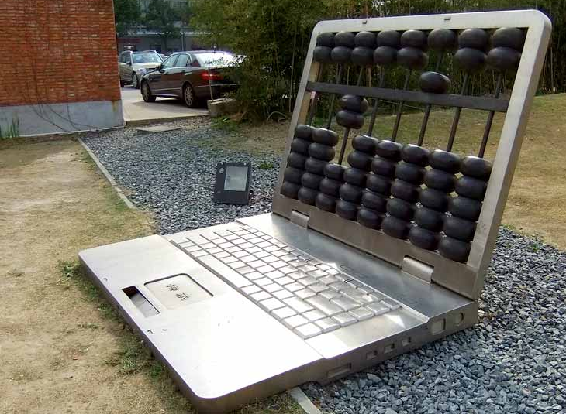
What could future information systems look like?
Improvements in the way we produce and provide food require solutions that are adopted to local conditions and the diversity amongst farm households.
The information needs to be much more spatially and temporally detailed than the information available from traditional sources.
The UN has called for a Data Revolution in Sustainable Development. The Global Strategy for Improving Agricultural and Rural Statistics addresses the lack of capacity to provide information on food and agriculture.
Notes:
Further improvements in the way we produce and provide food require solutions that are adopted to local conditions and the diversity amongst farm households.
The information we need to scope and target these interventions needs to be much more spatially and temporally detailed than the information available from traditional sources and the countries where gains need to be made are often the countries where information is at its poorest.
This need has been outlined in two major efforts to improve available information for agriculture and development: the call from the UN for a Data Revolution in Sustainable Development which emphasises the need for research and innovation in the way we collect and use data, and; the Global Strategy for Improving Agricultural and Rural Statistics which directly addresses the lack of capacity to provide reliable information on food and agriculture.
Image from https://rochester.edu/news/headlines/jan2014/abacus.jpg

Slide 9
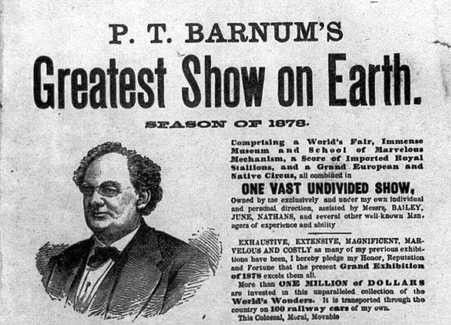
SDGs - The Greatest Data Show on Earth!
SDGs are the “Something for everyone”, PT Barnum approach to development goals.
SDGs - 17 goals, 169 targets, 230 indicators.
We don’t have the means to measure all of these yet, so the SDG process also has a very compelling R&D component.
What data are needed for baselines, what data are needed to monitor progress, who will do this, and how often? Who will rally around which goal/target? Do these goals fit with ag sector information needs?
Notes:
Focus on what matters. Sustainable Yield = Sustainable Profit (the social, economic and environmental triple bottom line)

Slide 10
Should we focus on what really matters?
Better sampling frames – how to measure the right thing, in the right places the right amount of times?
Digital non-destructive yield estimates – can we rapidly estimate yield with a smartphone?
Field area estimates – cloud, crowd or both?
Drones - Scaling up by scaling down
What is essential?
These are just some ideas on how to collect very basic but fundamental information related to crop production.

Slide 11
1 Sampling frames
Whether for research, survey, census or other purposes, we need to measure the right thing in the right places. Measuring is expensive so how do we optimize it?
Unparalleled access to EO data gives us the opportunity to stratify the landscape at multiple scales and design sampling schemes that sufficiently represent the observed variability. These schemes can adapt as the stratification is updated on a suitable timeframe. Current frameworks are often best guesses that are used for decades.

Slide 12
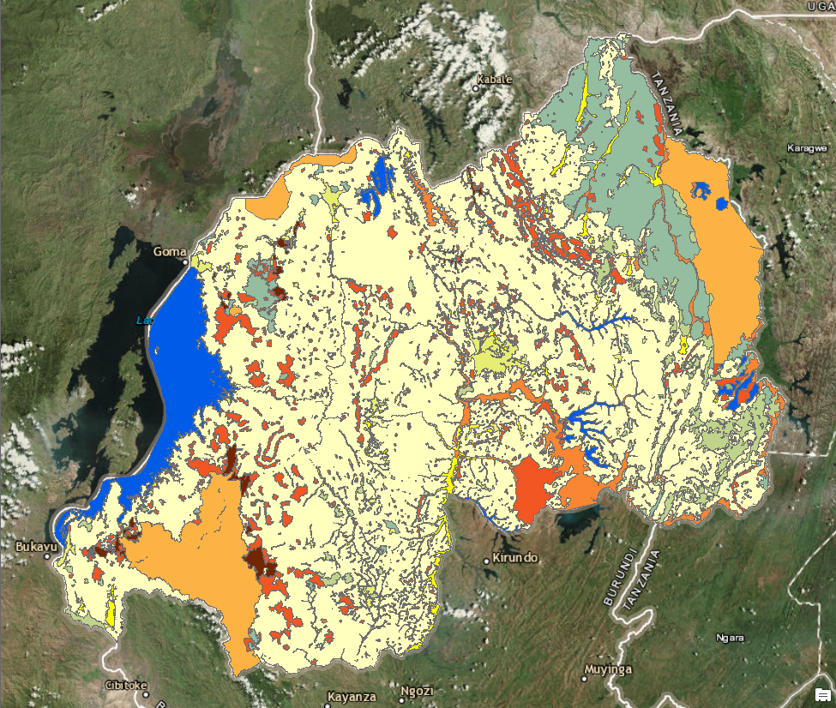
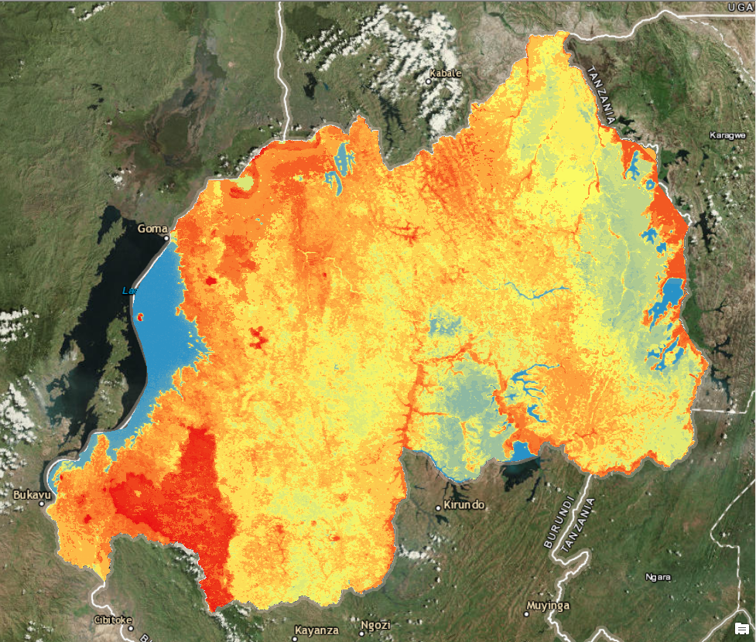
Area stratification for (nested or double) Area Frame agricultural surveys (Kees de Bie, ITC)
The case of Rwanda shows for the presently used strata [L] versus the NDVI-strata [R] :
that patterns generally coincide
that boundaries of R appear to have a much higher spatial detail then L (though R is coarser then L!)
that R shows gradients, missing in L
that 61% of Rwanda consists of (the “key” survey area), and that it is fully considered homogeneous (no sub-strata)
that within , R displays considerable spatial (temporal) differences that could seriously matter concerning the aimed at estimates
Rwanda Strata (NISR, 2015)
L
R
Intensive cropland (50-100% cultivation)
→ 61% of the country
Extensive cropland (15-50% cultivation)
NDVI Strata (95x) (Modis-Terra 2004-14)
→ R can be used to improve L
(no need to totally replace L)

Slide 13
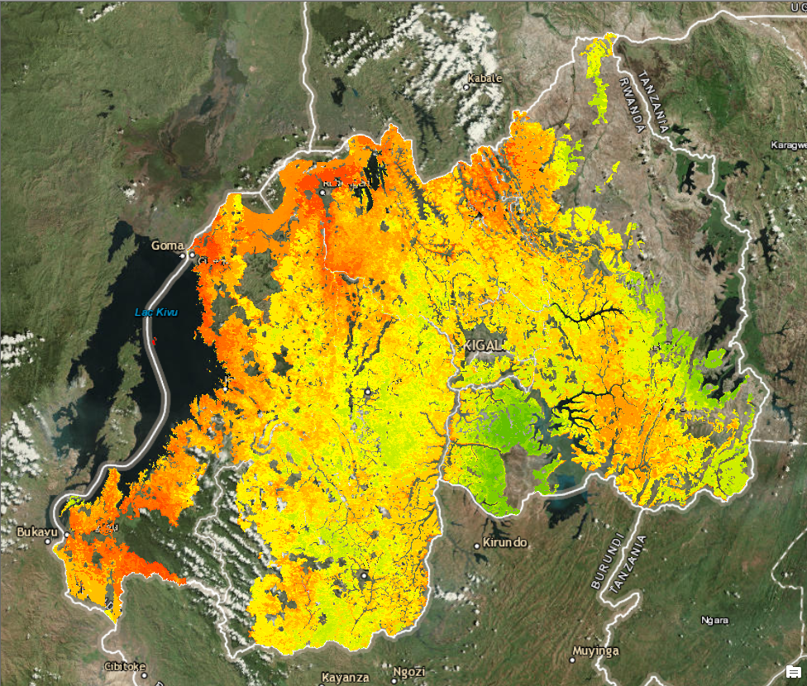
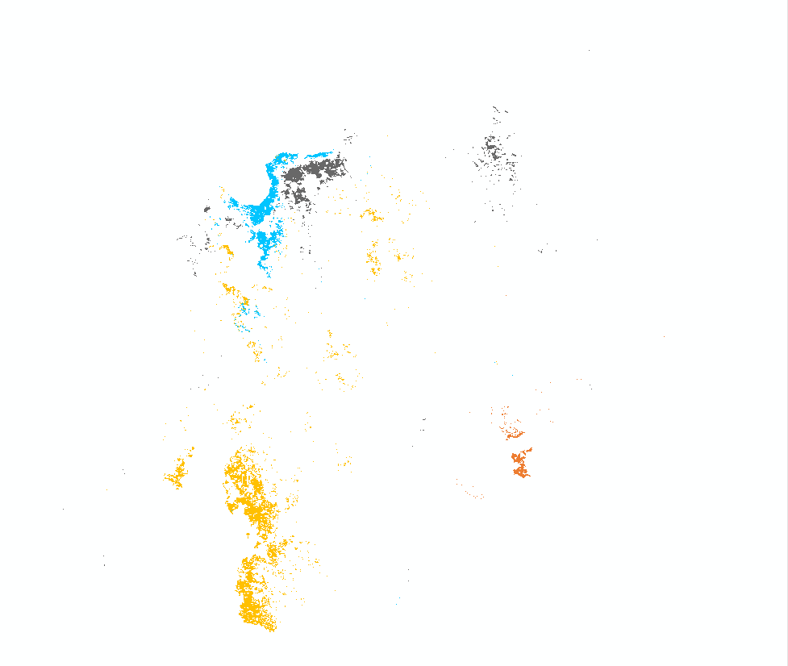
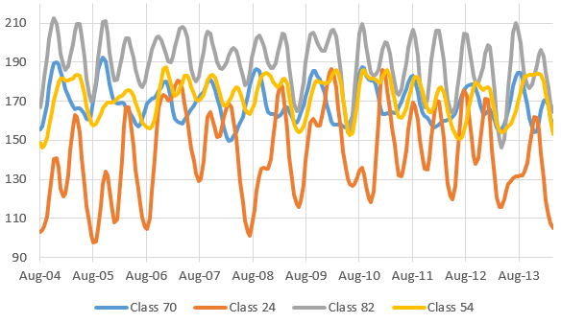
Area stratification for (nested or double) Area Frame agricultural surveys
… Continuation on Rwanda:
Four NDVI-profiles are shown below
Note: Colors are artificial

Slide 14
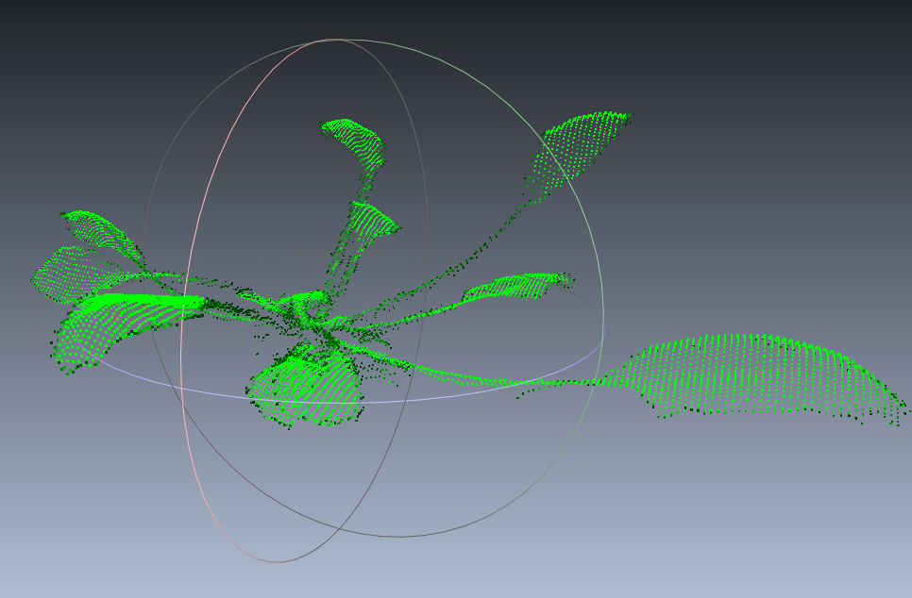
2 Estimating yield
Smartphones and tablets are used to collect on farm information and can even measure LAI and Nitrogen content, but what about yield?
Can we estimate yield based on point clouds from single or multiple photos of field crops? Or, LIDAR chips can now fit in a smartphone, can they be used to generate point clouds of crops to estimate yield? What other useful parameters could we derive from advances in 3D vision technology?

Slide 15
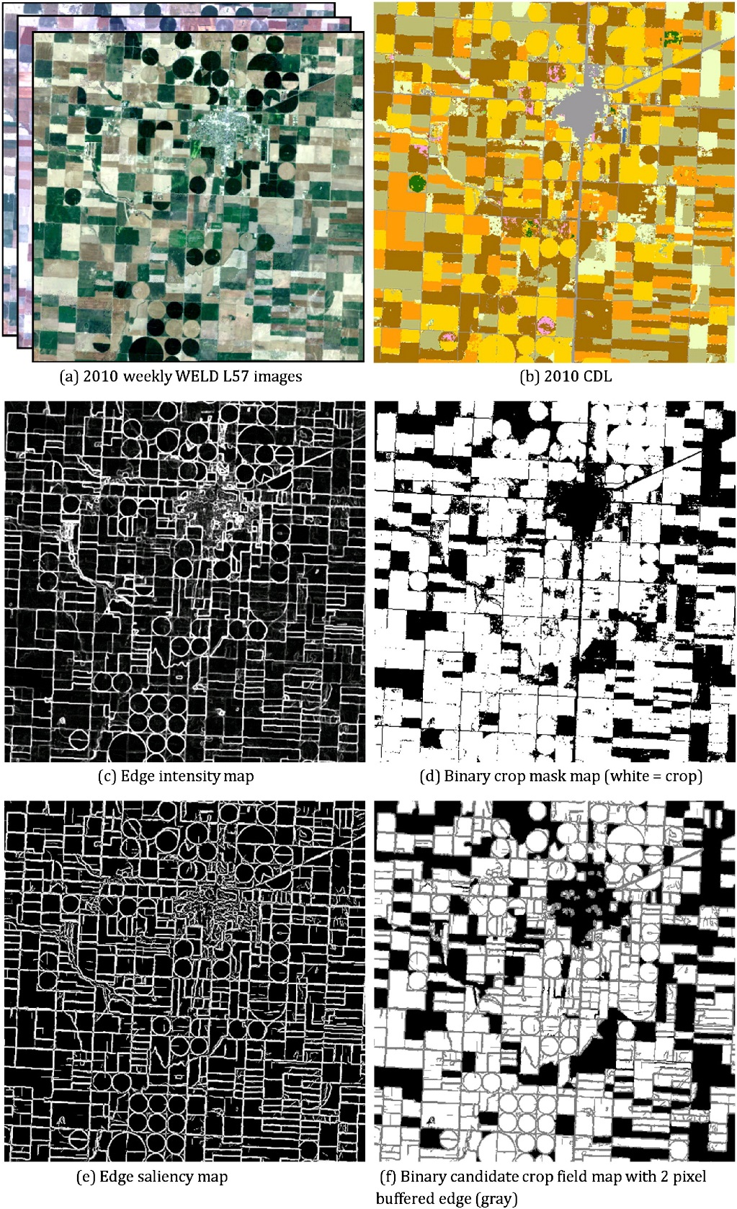
3 Where are the fields?
OpenStreetMap has been hugely successful. What if we could develop an OpenFieldMap?
Can field boundaries be digitized on demand when a field survey takes place, giving you area, yield and production estimates?
ITC will start a small study in Ethiopia that uses crowd sourced digitizing, ground based tracing and semi-automated methods to assess which works best under a range of environmental x smallholder conditions. There are so many applications where we need field boundaries that we cannot continue without them.
We need to link the information in the pixel to the management of the plot.
Knowing where fields and field boundaries are is essential for the correct interpretation of our observations of the land surface and vegetation cover at a level of detail that relates directly to land management.
Detecting field boundaries automatically from L. Yan, D.P. Roy, Conterminous United States crop field size quantification from multi-temporal Landsat data, RSE, Volume 172, January 2016, Pages 67-86,
Notes:
Where are the fields?
In the USA, landsat imagery has been used to demarcate fields that 10 hectares on average, much larger than many fields in Africa and Asia
The STARS and its4land projects use much higher resolution satellite or UAV imagery for smaller fields and this could be a solution for many areas, but there may be limits of what can be automatically extracted from diverse and complex landscapes.
Crowdsourcing approaches are also a viable option and can quickly cover large areas, but methods to validate and assess the quality of these efforts needs to be developed. Opening up archives of already collected field boundary information would also add to our knowledge. It is likely that all of these methods would play a role in improving information on where crops are grown.
OpenStreetMap, has shown that a community of mappers armed with a mixture of approaches can be incredibly successful in changing the way we use and access important geo-information for everyday life.
What would it take to make an OpenFieldMap? Would ITC have a role to play in a consortium or community whose aim would be to link the information in the pixel to the management of the plot anywhere in the world?

Slide 16
4 Drones, scaling up by scaling down
As prices drop and components shrink, will technology become accessible?
What if every farmer had a drone the size of box of matches, housed in a solar powered homebase, that could monitor the field from a few meters height once a day?
What if that homebase could compute a range of useful information from that monitoring and share it?
What if that information was shared not just with the farmer but also with various people in the value chain (IOT)?
What if the costs of that drone were part of a technology package that helped deliver services to the farmer?

Slide 17
And finally, what is essential?
The climate community has defined Essential Climate Variables
The biodiversity community is defining Essential Biodiversity Variables
The agriculture community is …
Do we need to / Can we agree on essential variables that will help improve our understanding of agricultural systems? How will they be collected, who will do it and who will own/curate the information?
Is the CGIAR Big Data / Open Data platform an opportunity to work out what these variables are and how to go about obtaining them?

Slide 18
Thanks

